Slide 1
The Future of Design of Experiments: is it “Optimal”?
Few insights on the applications and problems
Daniel Griffith & Eduardo Santiago
Minitab, Inc.
State College, PA

Slide 2
Outline
Optimal Designs
In what sense are optimal designs, optimal?
When do we use optimal designs?
A quick illustration of D-optimal designs
Available Algorithms: Point-exchange, Coordinate-exchange, and genetic algorithms.
Examples
The future

Slide 3
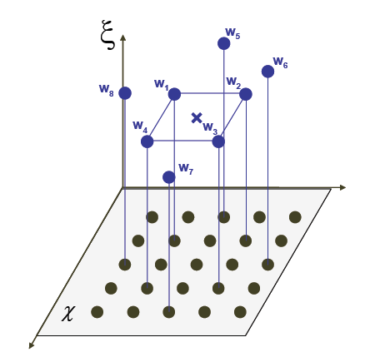
Optimal Designs
Optimal designs are experiments that have been derived using a mathematical criterion. These criteria focus on different aspects of modeling, e.g. estimating the parameters of a linear model with minimum variance, or reducing the overall prediction variance across the design region.
Fig 1. What is the best choice of runs for an experiment?
Notes:
Focus on the picture to get the general idea across the board of optimal designs being about picking the optimal set of runs from a wider set of points (candidate set) or an infinite number of points (if the design space is not discretized).

Slide 4

Optimal Designs
Optimal designs are flexible alternative approaches to the design of experiments. At the same time, optimal designs:
Allow for the estimation of model parameters with maximum precision. This implies the confidence intervals for all coefficients will be minimized, which practically speaking means more certainty in the parameter estimates.
Small average prediction variance across the design region. This property guarantees the prediction intervals will be narrow.
Notes:
The key here is Flexibility…optimal designs allow the user to customize and create a design that is unique to their specific needs. I wouldn’t focus on the technical aspects too much, mention it briefly (no need to read the slides). The information about the definitions for maximum precision and small avg. prediction variance can stay in the presentation in case the question is asked.

Slide 5
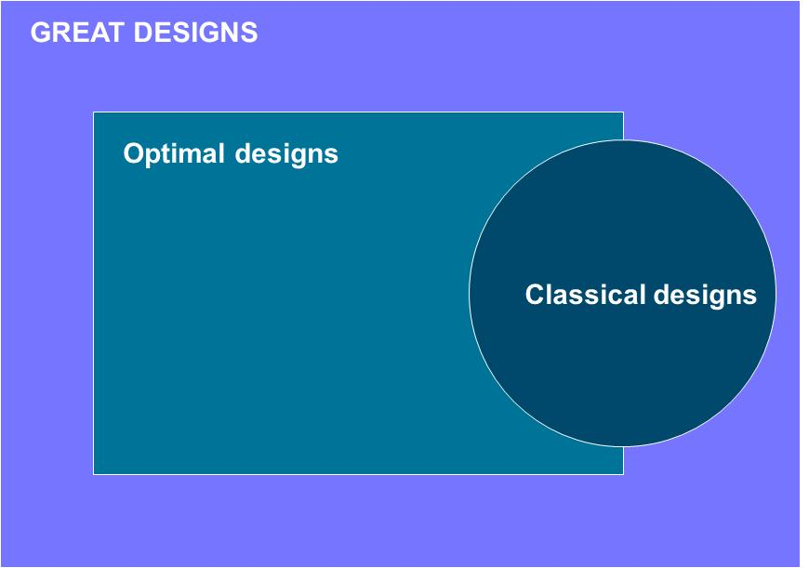
Optimal Designs
Notes:
Make a reference to Chris Nachtsheim presentation.
Some classical designs are also optimal which implies that optimal design algorithms can also generate a lot of the classic designs suggested in the literature.

Slide 6
In what sense are optimal designs, optimal?
Several optimality criteria exist (D-, I-, A-, E-, G-, etc.) however they are ALL related to the design in model form (X), the reason why is shown next.
The two most predominant are D- and I-optimality.
Fisher’s information matrix
Notes:
The key here is to convey the idea that the properties of estimates or the precision of prediction really depends on X, and not on the responses (Y). Don’t go over the details unless audience asks about it.

Slide 7
In what sense are optimal designs, optimal?
Some of these criteria (e.g. D-, E- and A-optimality) emphasize maximum precision, so the focus is on minimizing the inverse of the Fisher information matrix.
While some of the other criteria focus on prediction variance (e.g., I- and G-optimality).
Optimal designs are typically “optimal” only with respect to one of these criteria. [Sometimes designs will be optimal with respect to multiple criteria, but this is rarely the case]

Slide 8
A Quick Illustration – Power Wash Opt.
A team is investigating a power-wash process to clean steel couplings. Four important factors in the wash process and their current settings are considered. Suppose a Central Composite Design with 30 runs is proposed…do we need all 30 experimental runs to arrive to similar conclusions?
Variable | Description
Pressure (x₁) | Water pressure, psi (80, 140, 200)
Temp. (x₂) | Water temperature, ºF (160, 175, 190)
Time (x₃) | Wash cycle time, minutes (2, 4, 6)
Conc. (x₄) | Detergent concentration, % (2, 4.5, 7)

Slide 9
A Quick Illustration – Power Wash Opt.
30 runs provide sufficient information to estimate several terms in the model. In particular we can estimate: the constant, four main effects, six two-way interactions, four quadratic effects, and 15 DF allocated to estimate the error.
Are we performing too many runs?
Can we sacrifice a little orthogonality but save money by performing a shorter experiment?
Will the quality of the proposed solution be the same with fewer runs?

Slide 10
A Quick Illustration – Power Wash Opt.
The analysis below corresponds to the original 30 run CCD, using a significance level of 0.1.
The analysis was done using coded units.
Estimated Regression Coefficients for Steel
Term Coef SE Coef T P
Constant 89.217 1.867 47.789 0.000
Pressure 2.944 1.524 1.932 0.066
Temp 1.117 1.524 0.733 0.472
Time 2.622 1.524 1.720 0.099
Conc -3.344 1.524 -2.194 0.039
Conc*Conc -10.750 2.410 -4.460 0.000
Pressure*Conc -4.700 1.617 -2.907 0.008
Temp*Conc -3.900 1.617 -2.412 0.025
S = 6.46709 PRESS = 1568.41
R-Sq = 67.74% R-Sq(pred) = 45.02% R-Sq(adj) = 57.48%

Slide 11
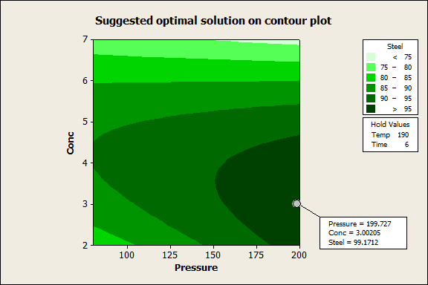
A Quick Illustration – Power Wash Opt.
The recommended solution is Pressure = 200 psi, Concentration = 3%. Temperature = 190, and Time = 6 seconds. Expected response = 99.17%.

Slide 12
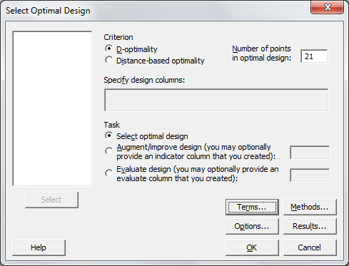
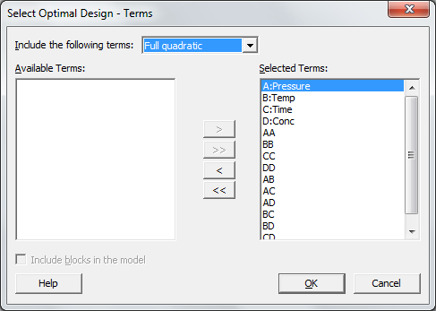
A Quick Illustration – Power Wash Opt.
Would the conclusions have changed if you only select 21 of the original 30 runs? Is the optimal solution comparable to the obtained with the original design?
Notes:
Describe the steps necessary: 1) You create an optimal design to find the best 21 points to maximize the information about the assumed model. 2) You get that subset of pts and refit the model. 3) Optimize and compare solutions.

Slide 13
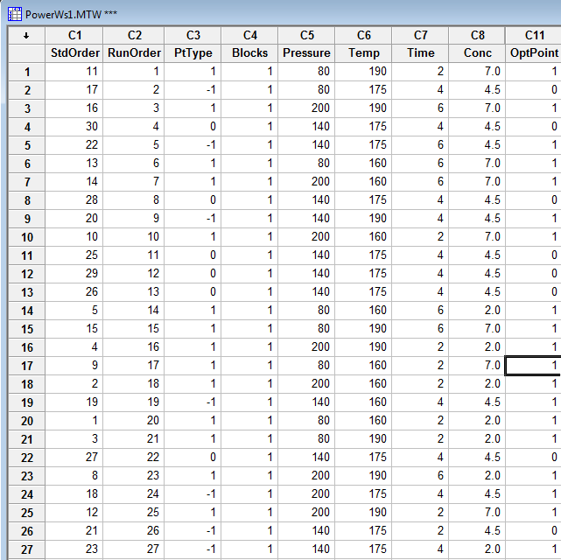
A Quick Illustration – Power Wash Opt.
Minitab proceeds to find the optimal subset of 21 runs that maximize the information about the model we want to fit.

Slide 14
A Quick Illustration – Power Wash Opt.
Is the D-optimal design orthogonal? If not, how strongly correlated will the terms in the model be?
Pressure Temp Time
Temp 0.000
1.000
Time -0.003 0.000
0.990 1.000
Conc 0.003 0.000 0.003
0.990 1.000 0.990
Cell Contents: Pearson correlation
P-Value

Slide 15
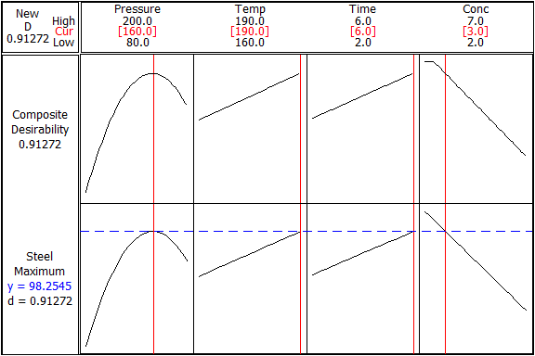
A Quick Illustration – Power Wash Opt.
Using the same responses for the complete CCD, we can fit a model to the corresponding responses collected for the 21-run D-optimal design.

Slide 16
When do we use optimal designs?
Classical designs not always apply.
Design for nonstandard sample sizes
Design in the presence of irregular design spaces
Design for constrained mixture experiments
Design augmentation (except if folding fractional design)
Design for experiments having both qualitative and quantitative factors
Design for nonlinear regression models
Designs for response surface models with an assumed third order polynomial or higher
Notes:
Illustrate some of the ones that you are easier to explain. Maybe adding a picture will be beneficial to some of them like (irregular design space).

Slide 17
When do we use optimal designs?
Unusual requirements concerning either the number of blocks or the block size
Designs for logistic regression and other exponential family models
Designs for situations in which there is heteroscedasticity across the design space
Designs that model potential and active factors (supersaturated designs)

Slide 18
THE ALGORITHMS

Slide 19
Available algorithms
Several algorithms have been devised to create optimal designs. In general, these algorithms fall under one of the three categories mentioned below:
Point-exchange algorithms (e.g. Fedorov, DETMAX), require the user to specify a candidate set of points (N). These algorithms start with a random design with n runs. The algorithm then assesses which point (a.k.a. run) from the current design can be replaced with any of the candidate points to improve the optimality criterion.
Coordinate-exchange algorithms. Does not require a candidate set of points and evaluates the impact of changing a specific coordinate of the design at a time. Computationally faster.
Genetic algorithms. Flexible to find any criterion, perform a continuous search of the design space (no candidate set), but computationally slower than the algorithms falling under the other two categories. Does not require a random start design.
Notes:
Say why you believe the coordinate exchange algorithm is more robust and performs no worse than the other algorithms. If for presentation you decide it is better to make this into a table that compares all three methods, go for it.

Slide 20
Coordinate Exchange Algorithm
Why is it so powerful? It’s faster b/c computations are based on simpler changes on coordinates not row vectors (as traditionally done by point exchange methods).
Start by taking the number of factors, type, levels, runs, and assumed linear model. Create a random design, such that |X’X| ≠ 0. For example, for a four run design with two continuous factors and a main effects model:
We find the best change in [-1, 1] to maximize the determinant
For D-optimality:
|X’X| = 6.43039

Slide 21
Coordinate Exchange Algorithm
The trick to the efficiency of the algorithm is that there is a computationally cheap formula (Δ^{ij}) to calculate the change in the determinant corresponding to the change in that specific coordinate.
Best change is –1; now proceed to find the best coordinate exchange for –0.67.
X₁₂ | Δ^{ij} | |X’X|
-0.53 | 1 | 6.4304
-1 | 1.2036 | 7.7398
0 | 0.9022 | 5.8017
1 | 1.0984 | 7.0633

Slide 22
Coordinate Exchange Algorithm
You iterate multiple times over every coordinate until the change in the determinant is minimum or |X’X| reaches its upper bound of n^{p}.
The order in which the columns are optimized can be selected at random.

Slide 23
EXAMPLES

Slide 24
Design Augmentation
A manufacturer of roofing shingles wants to know the key variables that affect granule loss – the amount of granules removed from a shingle during a scrub test. Engineers have suggested that six variables could significantly impact granule loss.
Variable | Description
Moisture (x₁) | Amount of moisture on shingles (0.5, 1.5)
Pressure (x₂) | Application pressure, psi (20, 36)
Sheet Tension (x₃) | Sheet tension in pounds (10, 35)
Viscosity (x₄) | Coating Viscosity, centipoise (2000, 4500)
Filler%. (x₅) | Percentage of filler used in coating (40, 50)
Line Speed (x₆) | Speed of the line in ft/min (650, 750)

Slide 25
Design Augmentation
After analyzing and reducing the model…
Estimated Effects and Coefficients for GranuleLoss (coded units)
Term Effect Coef SE Coef T P
Constant 244.69 4.172 58.65 0.000
Press 47.12 23.56 4.172 5.65 0.000
Viscosity -71.13 -35.56 4.172 -8.52 0.000
Filler% -47.38 -23.69 4.172 -5.68 0.000
LineSpeed -21.88 -10.94 4.172 -2.62 0.026
Press*Viscosity -24.88 -12.44 4.172 -2.98 0.014
S = 16.6872 PRESS = 7128.64
R-Sq = 93.85% R-Sq(pred) = 84.25% R-Sq(adj) = 90.77%

Slide 26
Design Augmentation
Factors: 6 Base Design: 6, 16 Resolution: IV
Runs: 16 Replicates: 1 Fraction: 1/4
Blocks: 1 Center pts (total): 0
Design Generators: E = ABC, F = BCD
Alias Structure
I + ABCE + ADEF + BCDF
A + BCE + DEF + ABCDF
B + ACE + CDF + ABDEF
C + ABE + BDF + ACDEF
D + AEF + BCF + ABCDE
E + ABC + ADF + BCDEF
F + ADE + BCD + ABCEF
AB + CE + ACDF + BDEF
AC + BE + ABDF + CDEF
AD + EF + ABCF + BCDE
AE + BC + DF + ABCDEF
AF + DE + ABCD + BCEF
BD + CF + ABEF + ACDE
BF + CD + ABDE + ACEF
ABD + ACF + BEF + CDE
ABF + ACD + BDE + CEF
Since this is a Resolution IV design, what if the engineers suspect that the CF interaction could have been significant? How do you estimate both terms?
Notes:
If you would have thought about this before the experiment was run you could have fixed the problem easily?
By reassigning letters C or F.
Folding the design
Choosing a D-optimal design with say 20 runs to fit the model for B, C, D, E, F, BD, CF.

Slide 27
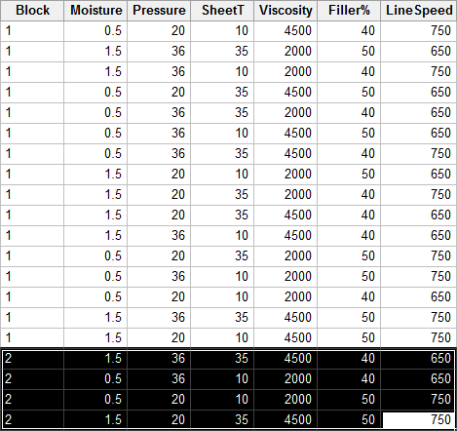
Design Augmentation
Using the coordinate exchange algorithm, we can find four additional runs that allow for the estimation of both interactions. D-efficiency is 89%.

Slide 28
Design Augmentation
Moisture Pressure SheetT Viscosity Filler% LineSpeed BD
Pressure 0.000
SheetT 0.200 0.000
Viscosity 0.200 0.000 0.200
Filler% 0.000 -0.200 0.000 0.000
LineSpeed 0.000 -0.200 0.000 0.000 0.200
BD 0.000 0.000 0.000 0.000 0.000 0.000
CF 0.000 0.000 0.000 0.000 0.000 0.000 0.600
Cell Contents: Pearson correlation
Notes:
This is the correlation matrix for the augmented design, from 16 we added four runs in a second block. Notice that high correlation between BD and CF, this is expected since for the first 16 runs they were confounded. The additional four runs break this confounding, but it is still partial and kind of high.

Slide 29
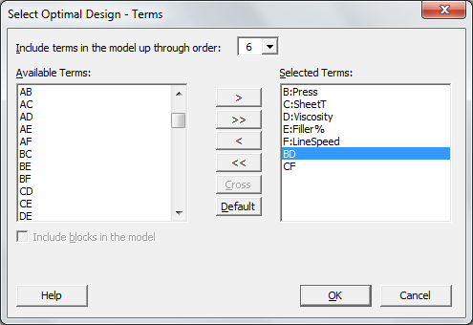
Design Augmentation
Folding is usually an option. That would add 16 more runs to the experiment. However, folding a Resolution IV design does not guarantee dealiasing of the confounded terms.
If you could have anticipated that these two interactions would be significant, you could have chosen a design with 20 runs that minimizes the partial confounding and allows for the estimation of all terms on the right.

Slide 30
Design Augmentation
Minitab’s D-optimal design for 20 runs shows a low degree of multicollinearity between the terms of interest.
Sometimes however, you can’t anticipate the importance of terms that can be confounded with each other.
Press SheetT Viscosity Filler% LineSpeed BD
SheetT -0.200
Viscosity 0.000 0.000
Filler% -0.000 0.000 -0.000
LineSpeed 0.000 0.000 0.200 0.000
BD 0.000 0.000 0.000 0.000 0.000
CF 0.000 0.000 0.000 0.000 0.000 -0.200
Cell Contents: Pearson correlation
Notes:
This is the correlation matrix for the D-optimal design generated by Minitab.

Slide 31
Balanced Incomplete Block Designs
Four catalysts are being investigated in an experiment. The experimental procedure consists of selecting one of the six batches of raw material, loading the pilot plant, applying each catalyst in a separate run and observing the reaction time. The batches of raw material are considered as blocks, however each batch is only large enough to permit three catalysts to be run.
One factor with four treatments.
Six blocks with a limitation that forces only three of the treatments to be tested under each block.
N = 18 runs total are needed.

Slide 32
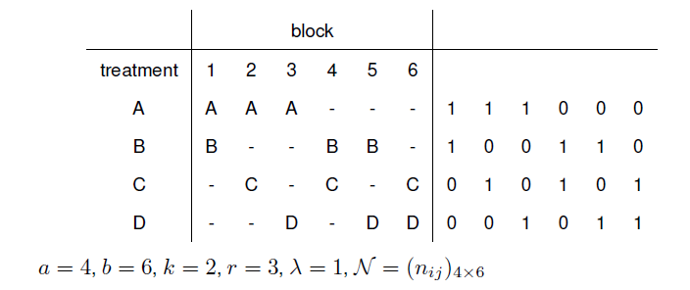
Balanced Incomplete Block Designs
Use your code’s interface and solve this problem. Make a picture with your design like the one below. BIBD for one factor can be determined empirically when you consider only one factor, but why is this approach advantages? Designs can be created for any type of blocking (not just balanced).

Slide 33
Disadvantages of using an OD
The model is assumed to be known. However, classical designs also assume that! Screening experiments assume only main effects are significant; response surface designs assume only quadratics, main effects, and two-way interactions are significant.
Treating it like a black box optimization routine can produce designs that are poor choices. (Example)
Optimization problem is difficult to solve and no current algorithm will give the absolute globally best design. It is always good to check if running the command multiple times generates the same design (software should start at different random starting points every time).
Notes:
In the example, just say if the user has five factors and creates a 20 run design where all you cared about was to estimate main effects and two-way interactions. The D-optimal design would be in terms of |X’X| criterion the best one, but a great choice will be the 2**(5-1) with four center points: it is orthogonal, estimates all main effects and two-way interactions, checks for curvature, and has a pure estimate of error.

Slide 34
The Future
Most practitioners find Design of Experiments overwhelming, especially when it to picking the right design.
Optimal design routines can make that easier and more transparent.
However it is necessary to add controls and checks to see if a classical design with center points might be a suitable choice as well, instead of just going with the I- or D-optimal design.

Slide 35
APPENDIX
Notes:
Can be completely skipped, but it is always a good idea to have it there just in case.

Slide 36
Appendix: Optimality Criteria
The ultimate goal is to produce a design that minimizes the uncertainty in the parameter estimates.
This is equivalent to minimizing the variance of the estimated coefficients.

Slide 37
The D-optimality criterion
D-optimality is probably the most common criterion and mathematically it maximizes the determinant of (X^{T}X) which is equivalent to minimizing the variances and covariances in the equation above.
This optimality criterion is measured in multiple ways:
SAS and JMP report this number.

Slide 38
The A-optimality criterion
A-optimality focuses on minimizing the sum of the coefficient variances. This criterion results in minimizing the average variance of the estimates of the regression coefficients.
There is another criterion related to Fisher’s information matrix, this is E-optimality which attempts to minimize the maximum eigenvalue of the inverse of X^{T}X.

Slide 39
Criteria based on prediction variance
There are other criteria associated with the scaled prediction variance, v(x).
G-optimality focuses in minimizing the maximum prediction variance over the points chosen in the design space.

Slide 40
Criteria based on prediction variance
I-optimality is the integrated variance criterion and it minimizes the average variance prediction over a continuous region and not just m distinct points.

